Slide 1


<Amar Pandit>
<6/5/22>

Slide 2

Outline
Executive Summary
Introduction
Methodology
Results
Conclusion
Appendix

Slide 3
Executive Summary
Summary of methodologies
Webscraping and the SpaceX API are used to obtain and manipulate the data.
Machine Learning was used to predict the best possible outcomes.
Data visualization theory and the creation of interactive visuals are used to reach conclusions about the data
Summary of all results
Using the above methodologies and available data, it is possible to determine the best features that will predict the success of the launchings.
This is supported by predictions made through machine learning to determine important features.

Slide 4
Introduction
Project background and context
Determine if the new company, SpaceY can successfully compete with SpaceX
Problems you want to find answers
Seeking to lower overall costs for launches by determining if landings will be successful.
Finding the best locations for launches.

Slide 5

Section 1

Slide 6
Methodology
Executive Summary
Data collection methodology:
Used the SpaceX API, https://api.spacexdata.com/v4/rockets/
Performed WebScraping on the provided data tables.
Perform data wrangling
Data was evaluated in order to determine confidence levels by which we could predict favorable launch conditions.
Perform exploratory data analysis (EDA) using visualization and SQL
Perform interactive visual analytics using Folium and Plotly Dash

Slide 7
Methodology
Perform predictive analysis using classification models
A train/test split was created from the collected data and then four classification models were used to verify the results.

Slide 8
Data Collection
Using Web Scraping and the SpaceX API, we were able to collect and manipulate the data.

Slide 9
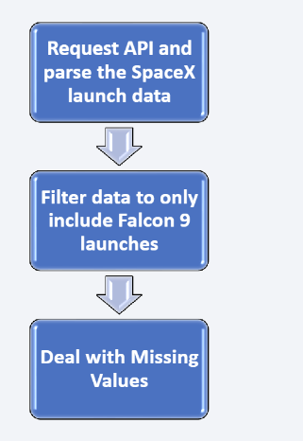
Data Collection – SpaceX API
Obtained data from the public SpaceX API which was used as shown in figure 1
https://github.com/Zamplifier/class10repo/blob/master/Class%2010%20week%201.ipynb
Figure 1: API Call Flowchart

Slide 10
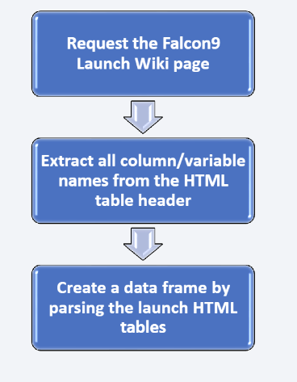
Data Collection - Scraping
Used Wikipedia as a source of the data.
Data were downloaded as shown in figure 2.
https://github.com/Zamplifier/class10repo/blob/master/Week%201%20Data%20Collection%20with%20WebScraping.ipynb
Figure 2: WebscrapingFlowchart

Slide 11
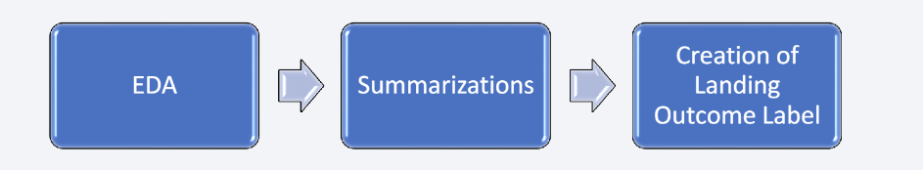
Data Wrangling
As shown in Figure 3, after completing initial EDA, key data was calculated and summarized including mission outcome and orbit occurrences.
From the outcome data, a landing outcome label was created.
Figure 3: Data Wrangling Flowchart
https://github.com/Zamplifier/class10repo/blob/master/Class%2010%20Week%201%20-%20Data%20Wrangling.ipynb

Slide 12
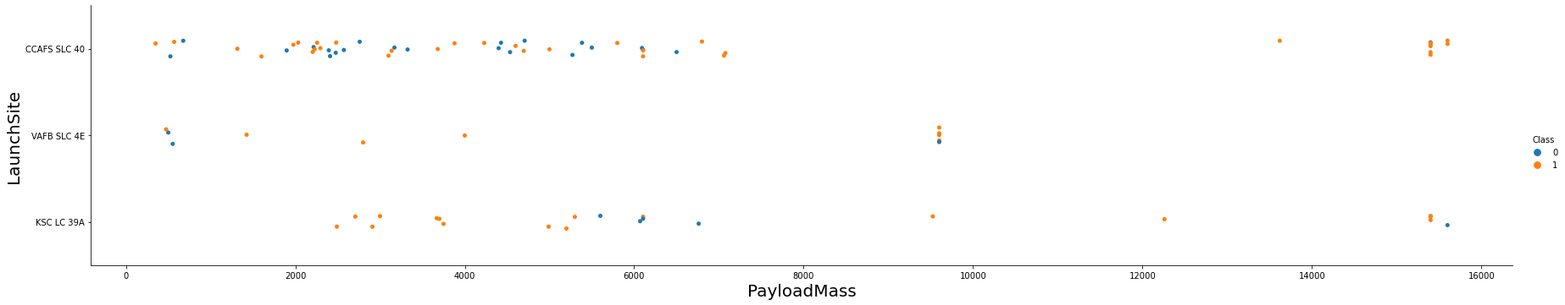
EDA with Data Visualization
The data was visualized using scatterplots (Figure 4) and bar graphs to show the correlation between the following features;
Launch Site and Flight Number
Launch Site and Payload Mass
Orbit and Flight Number
Payload Mass and Flight Number
Payload and Orbit
Figure 4: Launch Site vs Payload Mass
https://github.com/Zamplifier/class10repo/blob/master/Coursera%20Week%2010%20Week%202%20-%20EDA%20with%20Visualization.ipynb

Slide 13
EDA with SQL
Performed the below SQL queries and found;
Names of the unique launch sites.
5 launch sites with names beginning with “CCA”.
The total payload mass carried by NASA boosters.
The Average payload mass carried by booster version F9 v1.1.
Date of first successful ground pad landing
Booster names that were successful in drone ship operations.
Payload mass between 4000 and 6000kg
Numbers of successful and failed missions
Booster versions which have carried the maximum payload mass
Drone ship failed landing outcomes
Failed landing outcome booster versions and launch site names in 2015.
Successful and failed landing outcomes between 2010 and 2017.
https://github.com/Zamplifier/class10repo/blob/master/Coursera%20Class%2010%20Week%202%20-%20EDA%20with%20SQL%20.ipynb

Slide 14
Build an Interactive Map with Folium
The created folium maps were fit with the following features;
Launch sites were indicated by markers
The Space Centers were indicated by circles and highlights
Marker clusters show event groups such as launches and launch sites
Lines show the distance between locations.
https://github.com/Zamplifier/class10repo/blob/master/Class10Week3%20%20InteractiveVisualAnalyticswithFolium.ipynb

Slide 15
Build a Dashboard with Plotly Dash
The below plots and graphs were created;
Successful launches by site
Payload mass between 0kg and 9600kg
With this information, we can see the relationship between the launch sites and payloads. This will allow us to find the best launch location.
https://github.com/Zamplifier/class10repo/blob/master/Interactive%20Dashboard%20with%20Plotly%20Dash

Slide 16
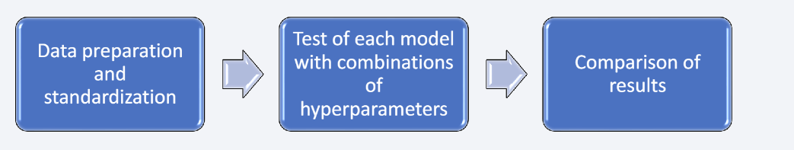
Predictive Analysis (Classification)
The following classification models were used (Process shown in Figure 5);
Logistic Regression
Decision Tree
K Nearest Neighbors
https://github.com/Zamplifier/class10repo/blob/master/Class%2010%20Week%204%20%20Machine%20Learning%20Predictions.ipynb
Figure 5: Predictive Analysis Flow Chart

Slide 17
Results
Exploratory data analysis results:
The first successful landing happened in 2015
There is a near 100% mission success rate
The later launches show better landing outcomes
There are four locations used by SpaceX for launches
A significant number of Falcon 9 booster versions landed successfully.
Booster versions F9 v1.1 B1012 and F9 v1.1 B1015 failed at landing in drone ships

Slide 18
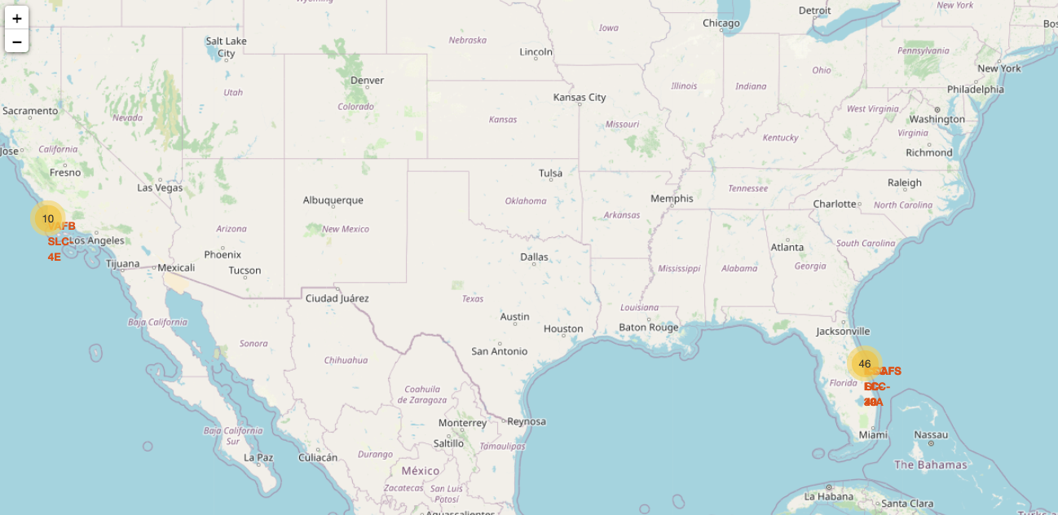
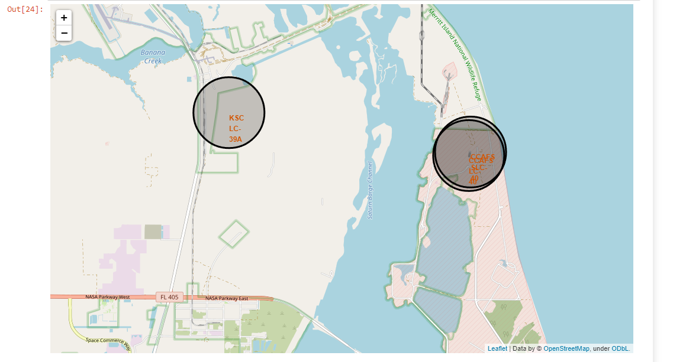
Results
Using folium maps, we can see that most of the launches are planned for the Florida launch site, where the infrastructure is favorable.
Figure 6: SpaceX Launch Sites
Figure 7: Most Favorable Launch Locations

Slide 19
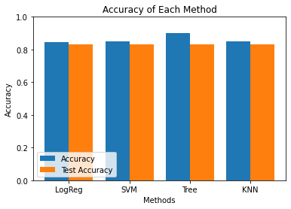
Results
Our analysis determined that the Decision Tree Classification is the best prediction model for successful landings.
The accuracy of the Decision Tree Classifier was 90%
Figure 8: Evaluation of Accuracies of Testing Methods

Slide 20

Section 2

Slide 21
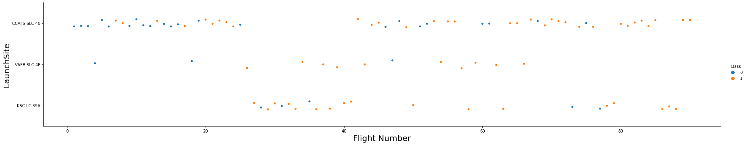
Flight Number vs. Launch Site
As shown in Figure 9, CCAF5 SLC 40 seems to be the location of the most successful launches.
Success rate has generally improved over time
Figure 9: Flight Number vs. Launch Site

Slide 22
Payload vs. Launch Site
Figure 10 shows that the high payloads, those >8000kg, seem to have the most success.
At >12,000kg, only CCAFS SLC 40 and KSC LC 39 seem to be the only possible launch sites.
Figure 10: Payload vs. Launch Site

Slide 23
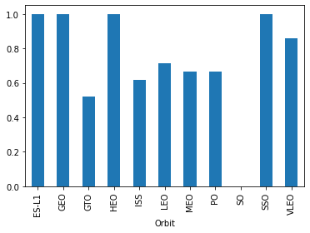
Success Rate vs. Orbit Type
Figure 11 shows that the following orbits had the highest success rates;
ES-L1
GEO
HEO
SSO
Figure 11: Success Rate vs. Orbit Type

Slide 24
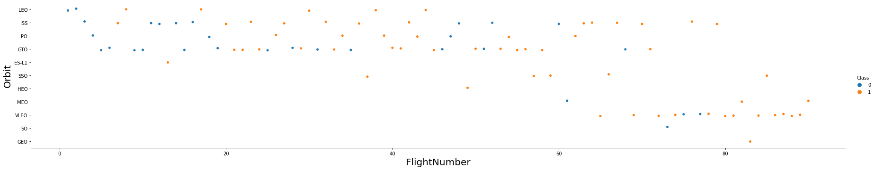
Flight Number vs. Orbit Type
In Figure 12. VLEO shows increased occurrence, which could be utilized in future endeavors
The trend supports that success rate improves over time.
Figure 12: Flight Number vs. Orbit Type

Slide 25
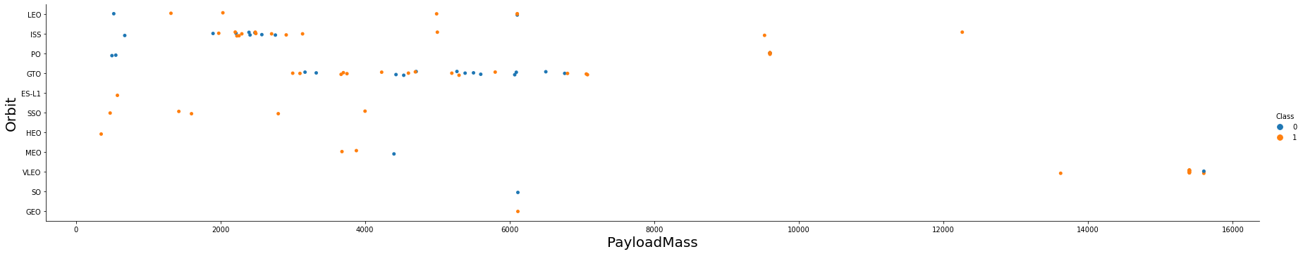
Payload vs. Orbit Type
In Figure 13, we can clearly see that the ISS orbit can accommodate a large payload range with a reasonable success rate.
While orbit GTO has success across a wide payload mass, it is very inconsistent with successes.
More data is needed to draw any conclusions on orbits SO and GEO.
Figure 13: Payload vs. Orbit Type

Slide 26
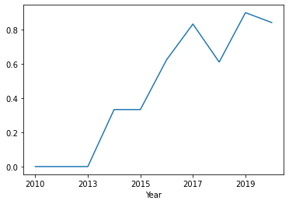
Launch Success Yearly Trend
Figure 14 shows that from 2013 onward, there is a sharp increase in success rate.
This seems to taper off near 2020, but more data is needed to confirm whether or not this is just a local minimum.
The rapid increase in success rate from 2013 to 2019 could be due to the process being highly iterative in the early years until most features were optimized.
Figure 14: Yearly Trend of Launch Successes

Slide 27
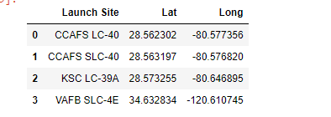
All Launch Site Names
Four unique launch sites are available as shown in Figure 15.
From the data, filtering code was used to select only unique launch sites.
Figure 15: Unique Launch Sites

Slide 28
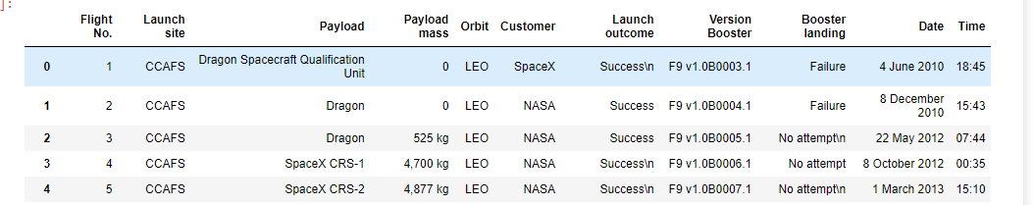
Launch Site Names Begin with 'CCA'
Figure 16 show five launches from Cape Canaveral, Florida
Figure 16: Five Launches from Cape Canaveral

Slide 29
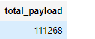
Total Payload Mass
Figure 17 shows the total payload mass in Kg for payloads carried by NASA boosters.
This was calculated by filtering the payloads by site codes containing “CRS” which refer to NASA.
Figure 17: Total Payload carried by NASA boosters in Kg

Slide 30
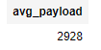
Average Payload Mass by F9 v1.1
Figure 18 shows that the average payload mass carried by booster F9 v1.1 is 2,928kg
This was calculated by selecting the booster version specifically in the data and averaging the payloads.
Figure 18: Average Payload Mass by F9 v1.1

Slide 31
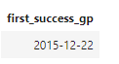
First Successful Ground Landing Date
Figure 19 shows the first successful ground pad landing.
This was obtained by using the MIN function on the DATE column and selecting for rows containing ‘Success (ground_pad).
Figure 19: Date of First Successful Ground Pad Landing

Slide 32
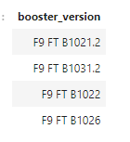
Successful Drone Ship Landing with Payload between 4000 and 6000
Figure 20 show the boosters which have successfully landed on a drone ship with a payload between 4000kg and 6000kg.
This was obtained by selecting distinct booster versions within the payload mass constraints.
Figure 20: Boosters for Successful Landings with Payloads between 4000 and 6000kg

Slide 33
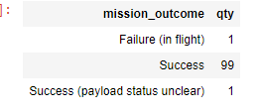
Total Number of Successful and Failure Mission Outcomes
Figure 21 was obtained by using the Count() function and grouping by Mission Outcome.
There were 99 successes, 1 success with an unclear payload status, and 1 in-flight failure.
Figure 21: Total Successful and Failed Missions

Slide 34
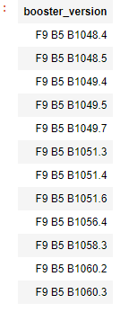
Boosters Carried Maximum Payload
Figure 22 shows only the boosters which were able to carry the maximum payload.
This was obtained by using the MAX() function on the “Payload_Mass_KG” column and selecting for distinct booster versions.
Figure 22: Boosters Which Have Carried the Maximum Payload

Slide 35
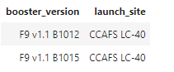
2015 Launch Records
Figure 23 shows the failed drone ship landings and launch site names in 2015
This was obtained by selecting for booster versions whose Landing_Outcome was listed as ‘Failure (drone ship)’
Figure 23: 2015 Failed Drone ship Landing Launch Site and Booster Version.

Slide 36
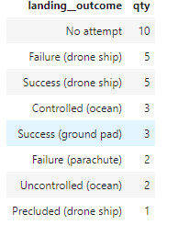
Rank Landing Outcomes Between 2010-06-04 and 2017-03-20
Figure 24 shows that ‘No attempt’ landing outcomes are the most common occurrence in this time frame.
This reinforces the need for favorable launch and landing locations and conditions.
Figure 24: Landing outcomes Ranked by Frequency

Slide 37

Section 3

Slide 38
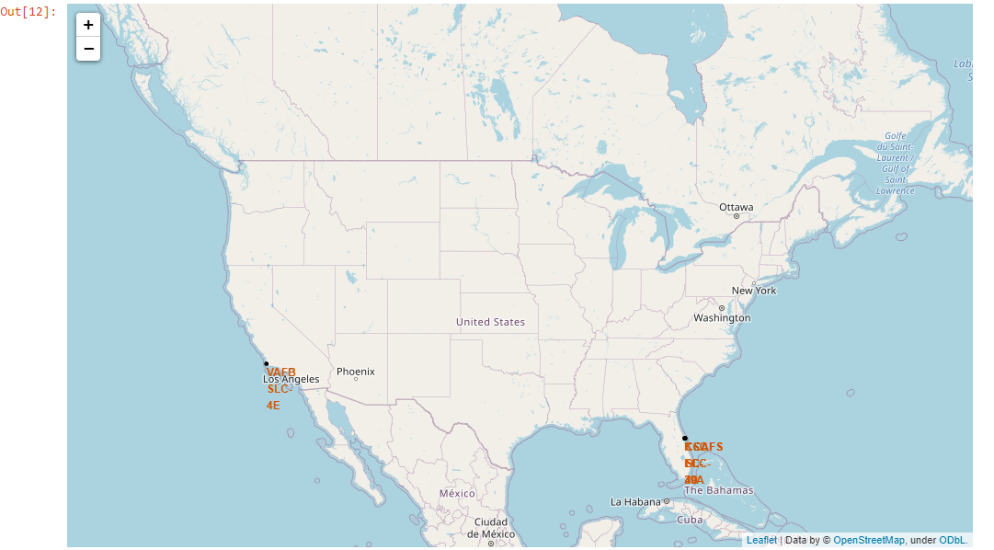
North American Launch Sites
As shown in Figure 25, the launch sites are located near coasts. This is most likely to ensure that there is plenty of safe landing locations.
Figure 25: Launch Sites in North America

Slide 39
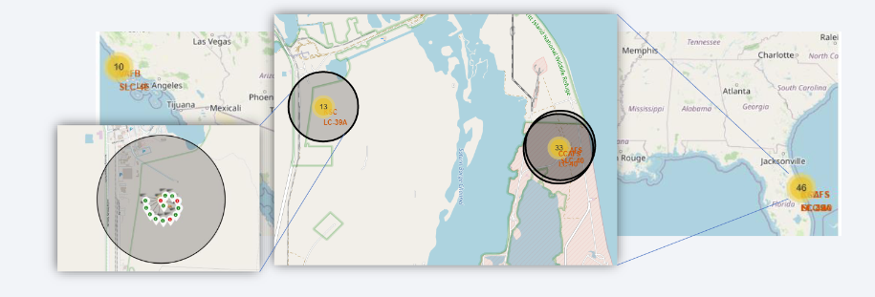
Launch Outcomes
The map in Figure 26 show the launch outcomes by site. Green for successes and red for failures.
Figure 26: Launch Outcomes Labeled by Color

Slide 40
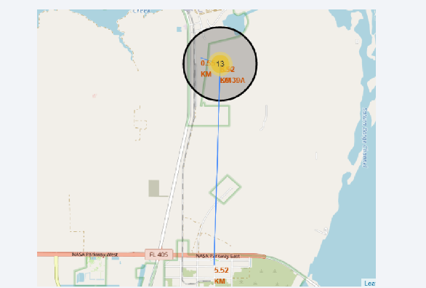
<Folium Map Screenshot 3>
Figure 27 is a good example of the logistical safety needs for launch sites.
The site itself is distanced from large housing areas and is near roads and railways.
Figure 27: Proximity Map of the KSC LC-39A Launch Site

Slide 41

Section 4

Slide 42
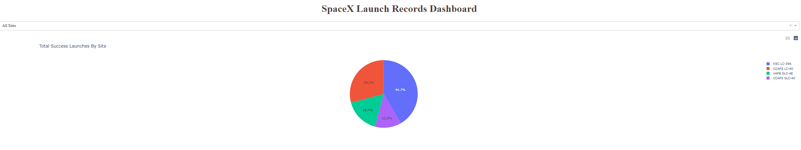
Successful Launches for Each Site
It can be clearly seen in Figure 28 that the KSC LC-39A launch site has a majority of the successful launches
Second best is the CCAFS LC-40 site, followed by VAFB SLC-4E and CCAFS SLC-40.
Figure 28: Pie chart Showing Counts of Successful Launches Divided by Launch Site

Slide 43
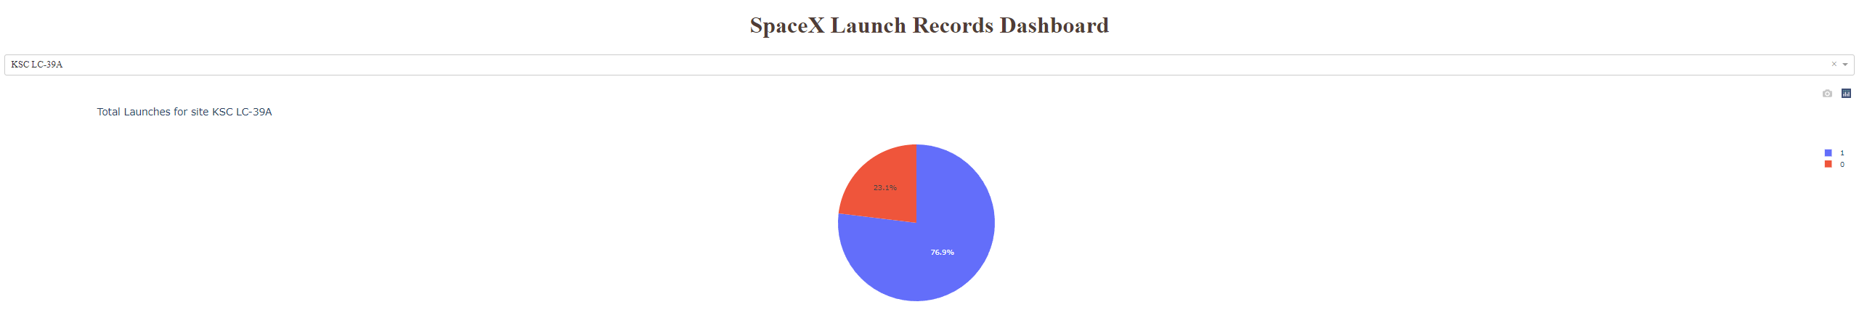
<Dashboard Screenshot 2>
Figure 29 shows us a closer look at the most successful launch site, KSC LC-39A.
76.9% of launches are successful and 23.1% fail.
Figure 29: Launch Successes and Failures at the KSC LC-39A Launch Site

Slide 44
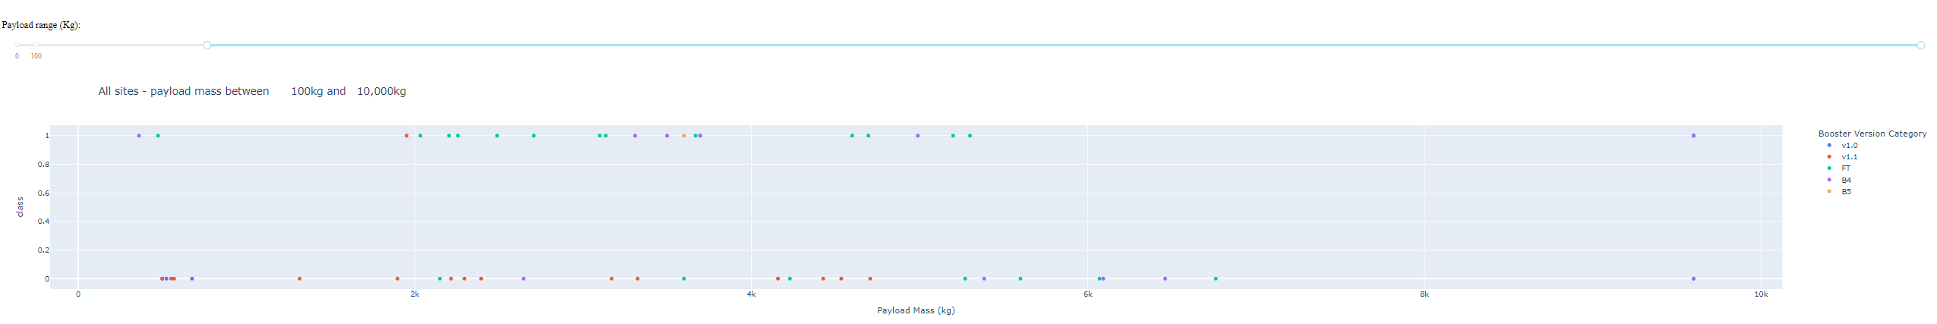
Payload vs. Launch Outcome Divided by BV
In Figure 30, we have plotted the payload mass by launch outcome. We have further categorized the data by showing the booster version by color.
Based on this, we can see that the FT Booster seems to be the most successful. While the v1.1 seem to be the least successful.
The most successes with the FT booster are between 2000kg and 4000kg
There is significantly less data for launches above 6000kg, so further research is needed to determine if there is any usable payload between 6000kg and 10000kg.
Figure 30: Scatterplot Showing Launch Outcome based on payload and booster version

Slide 45

Section 5

Slide 46
Classification Accuracy
As shown in Figure 8, four classification models were tested and plotted.
The decision tree classifier is the best overall method, with the highest overall accuracy and comparable test accuracy.
All tests show accuracies above 80%.
Figure 8: Evaluation of Accuracies of Testing Methods

Slide 47
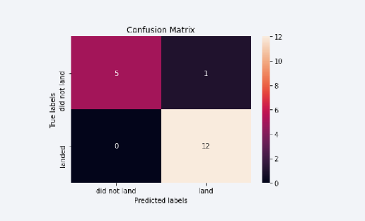
Confusion Matrix
In Figure 31 we can see that the data supports Decision Tree Classifier as the best model as there are larger numbers of true positives and true negatives
The false positives and negatives are very low.
Figure 31: Confusion Matrix of the Decision Tree Model

Slide 48
Conclusions
From the supporting evidence, the best scenario is as follows;
KSC LC-39A as the launch site.
Payloads between 2000kg and 4000kg
It is more likely to have a successful launch than a successful landing. The outcome of a launch improve with more attempts.
Decision Tree Classifier is the best method to determine if a landing will be successful.

Slide 49
Appendix
Had issues with Folium maps not showing any changes even with correct code.
Could not fix some issues due to the monthly limited processing quantity allotted by free Jupyter notebooks through IBM.

Slide 50


